Slide 1


Lecture 7 (2021-22)
Her and Him
Shruti Iyer

Slide 2
Outline for this week
What is sex and gender?
Examples of the narratives around sex/gender around us
Why does this matter for the study of politics?
Examples of empirical and normative politics research that look different when they account for gender roles

Slide 3
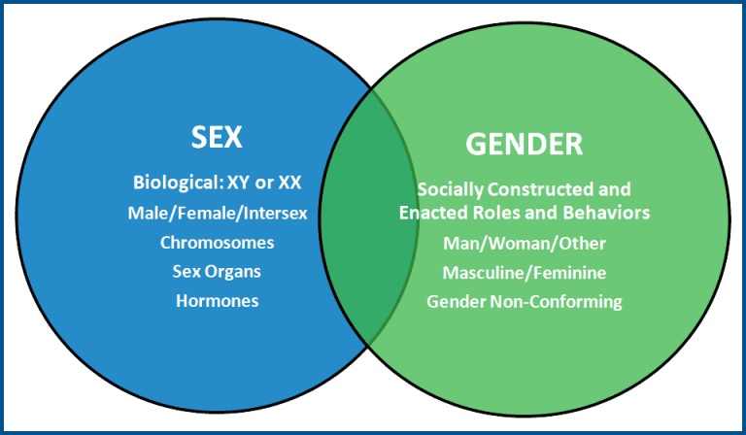
Sex vs. gender?
Sex – “socially agreed upon biological categorization, based largely on reproductive traits”
Gender – “the social process by which we assign roles, stereotypes, norms and behaviours to people based on their sex attributes”
Source: American Medical Women’s Association

Slide 4
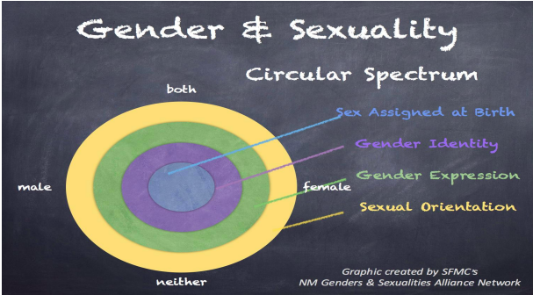
Gender isn’t really this or that…
Terms to know:
Gender roles + stereotypes
Gender identity
Gender expression
Sexual orientation
Notes:
Prescriptive and descriptive

Slide 5

Example 1: The egg and the sperm
Gendered language permeates narratives of biological conception
The sperm “race”, the egg as passive and inert
One task is unpicking gendered narratives/assumptions
But equally: testing them! What might we find?
Source: Getty Images
Notes:
This is actually an example of theory-ladenness. How culture shapes science

Slide 6

Example 2: Sex ‘testing’ in sport
Gender separation in sport
The practice of chromosome testing
Testosterone measurements
Clearly: there is no obvious binary between the categories male/female
And there might be differential outcomes – factoring in race
Fairness? Equity?
Photograph of Caster Semenya (left), Dutee Chand (right). Source: DNA News

Slide 7
Takeaways
Language matters!
Question ‘common sense’ ideas about gender and sex. (Remember the ‘mindset’ slide!)
Be attuned to disparities – in the university and beyond!

Slide 8
A provocation
Think of a gendered role that either you have taken on in your life, or one that you’ve seen people take on around you. This could be from a sport you play—or don’t play!—or a task you were expected to be better at than people of a different gender.
What stereotypes were associated with this activity? Why? Where did they come from?

Slide 9

The home as a site of politics
The feminist movement has long called into question the liberal distinction between the ‘public’ and the ‘private’ (Pateman, 1983)
‘The personal is political’
Reckoning with the household as a site of power and labour relations
Source: thethirdshift.co.uk
Notes:
Taking this call seriously means examining our everyday lives

Slide 10
The home as a site of unpaid work
‘In no country in the world do men and women provide an equal share of unpaid care work’ (ILO, 2018). ’Second shift’ or ‘double burden’
Some stats: in India, women spend 84% of their working hours on unpaid care-work, while men spend 80% of this time on paid activities (S Rukmini, 2020). An average Ghanaian woman is only paid for 40% of her working hours (Ferrant et al., 2014) . In 93% of all homes in the UK, women do more housework, even if they are the primary breadwinner; women do 60% more unpaid work than men (McMunn, 2019; ONS, 2016). In Sweden, women do 45 mins more of chores daily (Statistics Sweden, 2011).
Different in same-sex households??? (Giddings, 1998; Miller, 2018)
Notes:
Simone de Beauvoir – the Sisyphean torture of housework
iEvdence that this is the case globally from time-use surveys.
In India, women spend 84% of their working hours on unpaid care-work, while men spend 80% of this time on paid activities. An average Ghanaian woman is only paid for 40% of her working hours
In 93% of all homes in the UK, women do more housework, even if they are the primary breadwinners. Women do 60% more unpaid work than men. In Sweden, women do 45 mins more of chores daily

Slide 11
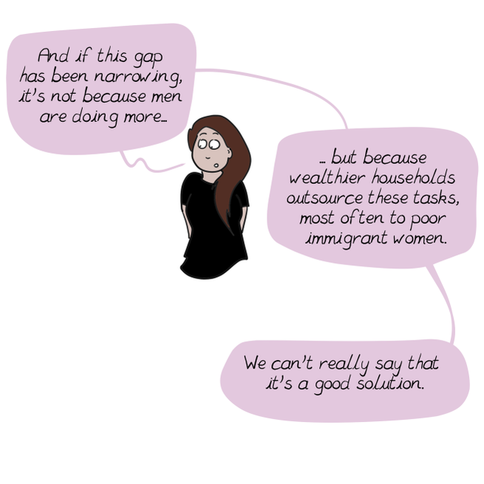
The home and waged work
Increasing numbers of im/migrant women employed as cleaners and carers, creating ’global care chains’ (Hochschild, 2014)
Unequal burdens of housework and child rearing often impacts labour force participation rates
Housework rendered ‘invisible’, difficult to measure
Source: english.emmaclit.com
Notes:
We now have a dual organization of care work in which those who can afford domestic help simply pay for it, while those who cannot scramble to take care of their families, often by doing the paid care work for the first group, and often at very, very low wages with virtually no protections.
Link to public/private again

Slide 12
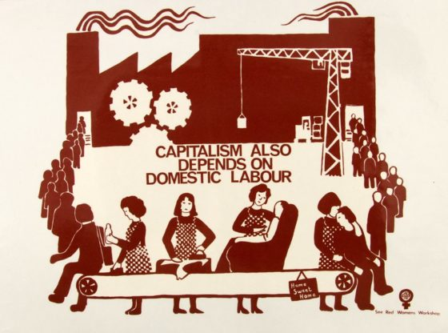
Housework in political theory
Several political philosophers emphasise the difference between “productive” and “unproductive” work (Adam Smith, Hegel, Marx)
In Marx, the category of the ‘wage-labourer’ is key
But: if workers produce the wealth of society, who produces the worker? (Bhattacharya, 2017)
Source: Radical History Review

Slide 13

Housework in political theory (pt. 2)
Seeing the world of work in both ‘production’ and ‘reproduction’
Implications for both liberal and Marxist theories of capitalism
Once we ask the question of ‘who does the dishes?’, what can we see?
Source: Sarah Fuller
Notes:
What does this mean for our theories of social change?

Slide 14
Housework in quantitative political economy
Missing from the measure of the Gross Domestic Product (GDP)
A crucial part of GDP measurement is the ‘production boundary’ (DeRock, 2021)
Looking at GDP as a measure of the economy or economic growth then misses a huge part of human activity
Impacts on policy interventions, well-being, demographic change
Notes:
In 2008, the authors of the newly updated System of National Accounts responded to their feminist critics by way of a compromise. They agreed to include the production of all goods – whether these were sold or not – in GDP calculations, so activities like weaving mats or brewing beer would be included.
However, they continued to exclude most unpaid household services, like cooking and cleaning.
-> why is it that GDP is incredibly important indicator?
-> so central to our understanding of how a country is doing
A devaluation of housework and unwaged work

Slide 15
Housework in quantitative political economy (pt. 2)
Increasing attempts to understand, measure and quantify care work
Suh (2021) aggregated time-use surveys and estimated that the value of unpaid care work in South Korea was anywhere between 22-59% of the national GDP in 2014
What might this mean? 10-11 million paid care workers would be needed to replace this unpaid work
Ageing populations, decline in fertility rates → higher need for care workers?
Notes:
Population of south korea

Slide 16
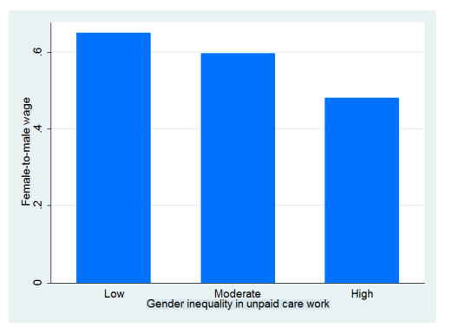
Housework in political economy (pt.3)
There is also a relationship between gender inequality in unpaid care work and lower rates of pay for women in the paid workforce (controlling for other variables)
Allows us to ask a different set of questions
Source: Ferrant et al. (2014)

Slide 17
The home in political science research
When men and women are separately interviewed in family planning surveys, men report wanting a larger ideal family size and have a lower demand for contraception (Banerjee and Duflo, 2012)
Ashraf et al. (2010) ran an experiment in Zambia comparing the results when some married women were given family planning vouchers in the presence of their husband and some without
Gender matters for research methods too!

Slide 18
Conclusion
Examining gender roles and stereotypes opens up a whole range of questions about the world we live in
What is ‘private’ or ‘personal’ can also be political!
Questioning our intuitions is about thinking like a social scientist
Being attentive to the social world should factor into our research methods

Slide 19
Resources and acknowledgments
NPR did a 12 min episode called ‘Is the Sperm Race a Fairy Tale?’ on Short Wave, available here.
The podcast Radiolab has an excellent series called ‘Gonads’. The episode on Dutee Chand’s story is available here.
Aliya Hamid Rao has a great book called Crunch Time (2020), where she looks at how college-educated married couples in the US confront unemployment. Oakland, CA: University of California Press. See this too.
Emma’s cartoon called ‘You Should’ve Asked’, available here.
There’s some data from UN Women on increased housework burdens during COVID here.
There’s an ILO report from 2018 on care work and care jobs here that has an incredible amount of detail on paid and unpaid care work.
And finally: credit goes to Cristina J for last year’s lecture (which informed slide 3!) and Archit Jain for pointing me to the family planning studies. ☺

Slide 20
References
Ashraf N., Field E., and Lee J. (2010) ‘Household Bargaining and Excess Fertility’, The American Economic Review, 104(7), pp.2210-2237.
Banerjee A. and Duflo E. (2012) Poor Economics: A Radical Rethinking of the Way to Fight Global Poverty. New York: Public Affairs.
Bhattacharya, T. (2017) ‘Introduction: Mapping Social Reproduction Theory’ in Bhattacharya, T. (eds.) Social Reproduction Theory: Remapping Class, Recentering Oppression, pp 1-38. London: Pluto Press.
Derock D. (2019) ‘Hidden in Plain Sight: Unpaid Household Services and the Politics of GDP Measurement’, New Political Economy, 26(1), pp. 20–35.
Ferrant G., Pesando L. and Nowacka K. (2014) ‘Unpaid care work: The Missing Link in the Analysis of Gender Gaps in Labour Outcomes’, OECD Development Centre Report.
Giddings L. (1998) ‘Political Economy and the Construction of Gender: The Example of Housework within Same-Sex Households’, Feminist Economics, 4(2), pp. 97–106.
Hochschild, A. (2000), ‘Global Care Chains and Emotional Surplus Value’, in Hutton, W. and Giddens, A. (eds.) On the Edge: Living with Global Capitalism, pp. 130–146. London: Jonathan Cape.

Slide 21
References (pt. 2)
Martin E. (1991) ‘The Egg and the Sperm: How Science Has Constructed a Romance Based on Stereotypical Male-Female Roles’, Signs, 16(3), pp. 485–501.
McMunn A., Bird L., Webb E., et al. (2019) ‘Gender Divisions of Paid and Unpaid Work in Contemporary UK Couples’, Work, Employment and Society, 34(2), pp. 155–73.
Messac L. (2018), ‘Outside the Economy: Women’s Work and Feminist Economics in the Construction and Critique of National Income Accounting’, The Journal of Imperial and Commonwealth History, 46(3), pp. 552–578.
Miller, C.., ‘How Same-Sex Couples Divide Chores, and What It Reveals About Modern Parenting, The New York Times, May 16, 2018.
Office of National Statistics (2016) ‘Women shoulder the responsibility of ”unpaid work”’ (online).
Office of National Statistics (2018), ‘Household satellite account, UK: 2015 and 2016’. London: ONS.
Pateman C. (1983), ‘Feminist Critiques of the Public/Private Dichotomy’ in Benn S.I. and Gaus G.F. (eds.) Public and Private in Social Life. New York: St Martin’s Press.
S, Rukmini (2020) ’Less than 10% Indian men involved in household chores, shows latest survey’, India Today, Oct 13.
Statistics Sweden (2011), ’Men increase their share of unpaid housework’ (online).
Suh, Joo Yeoun (2021) ‘Estimating the Unpaid Care Sector in South Korea’, CWE-GAM Working Paper Series: 21-03. Washington, DC: American University.

